Slide 1

Space Penguins
Property Price Prediction using Satellite Imagery
Marlies Kovenock | Sachin Peruri | Jeffrey Wei | Teddy Tian | Roshan Tiwari

Slide 2
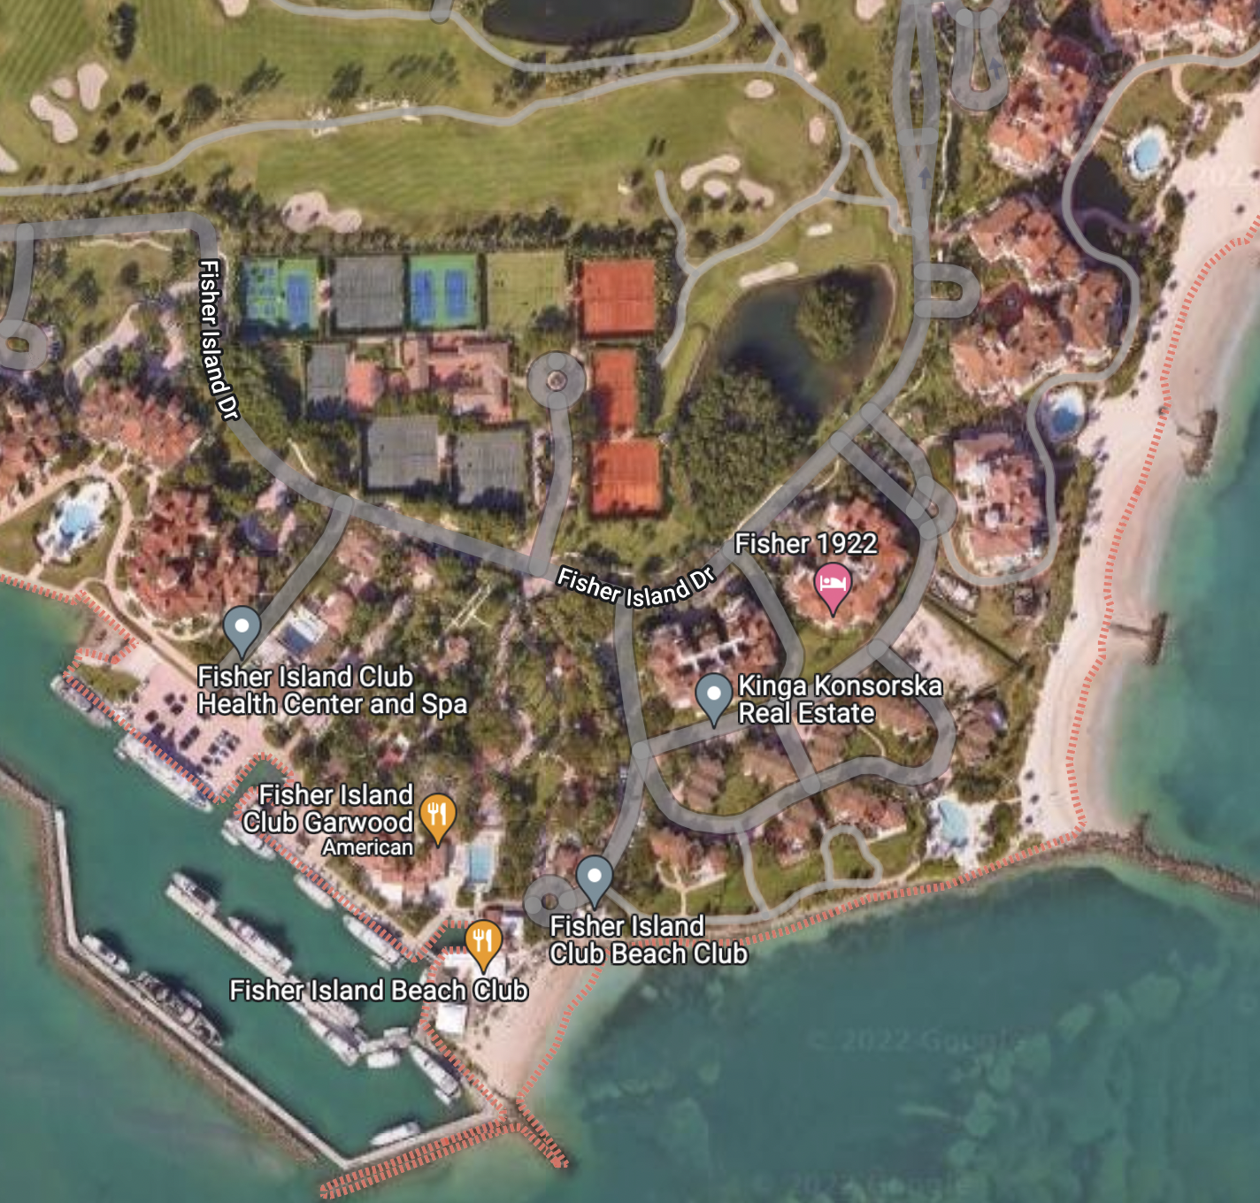
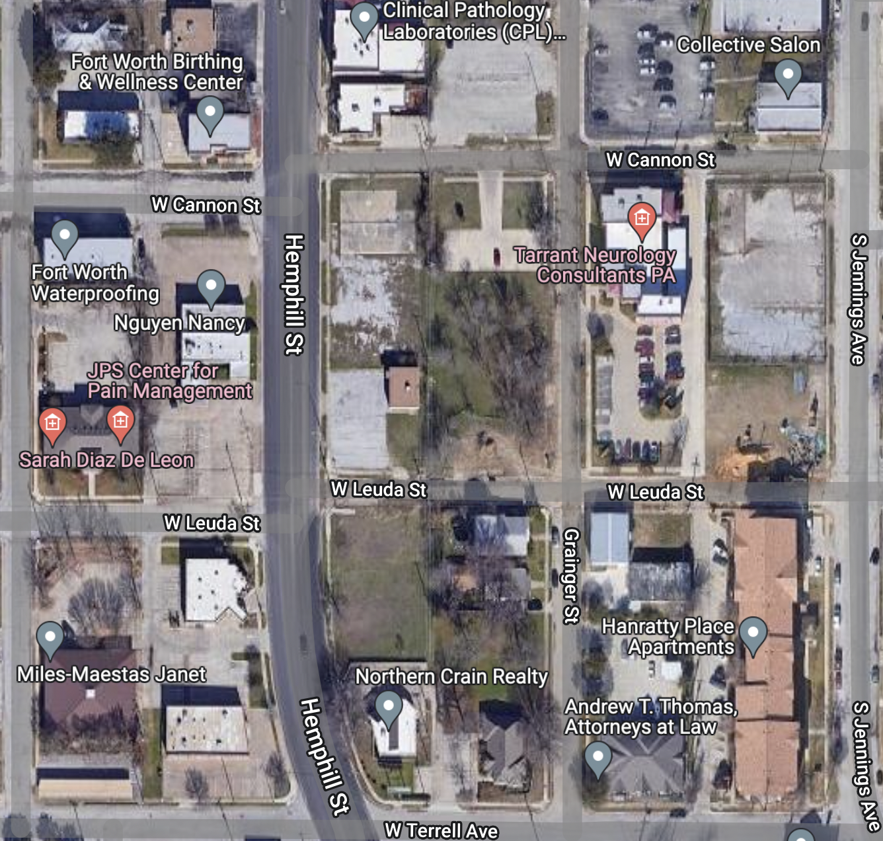
Introduction
Property price prediction is a key capability to acquire a business advantage over competitors.
Our model aims to provide a lightweight, easily scalable property price predictor that is universal and readily accessible.

Slide 3
Solution Design
ML models are notorious for requiring large amounts of labeled data for training
Our team envisioned an approach that has a reliable, accurate and cost-effective data source to address the property price prediction problem
We designed three solution approaches, and evaluated them to understand the pros and cons of each approach:
Only Satellite Imagery
Only Property Data
Satellite Imagery + Property Data

Slide 4

Solution Approach – Data Sources
Satellite Imagery:
Google Maps Static API
Property Data:
Text Search API
Distance Matrix API
Zillow Dataset – Orange County, CA

Slide 5
Solution Approach – ML Design
Satellite Imagery
Property Data
Only Satellite Imagery:
InceptionV3
Custom CNN model
Only Property Data:
Xgboost
Satellite Imagery + Property Data:
Custom hybrid model
Custom CNN
Dense
Concatenate
Property Price Prediction

Slide 6
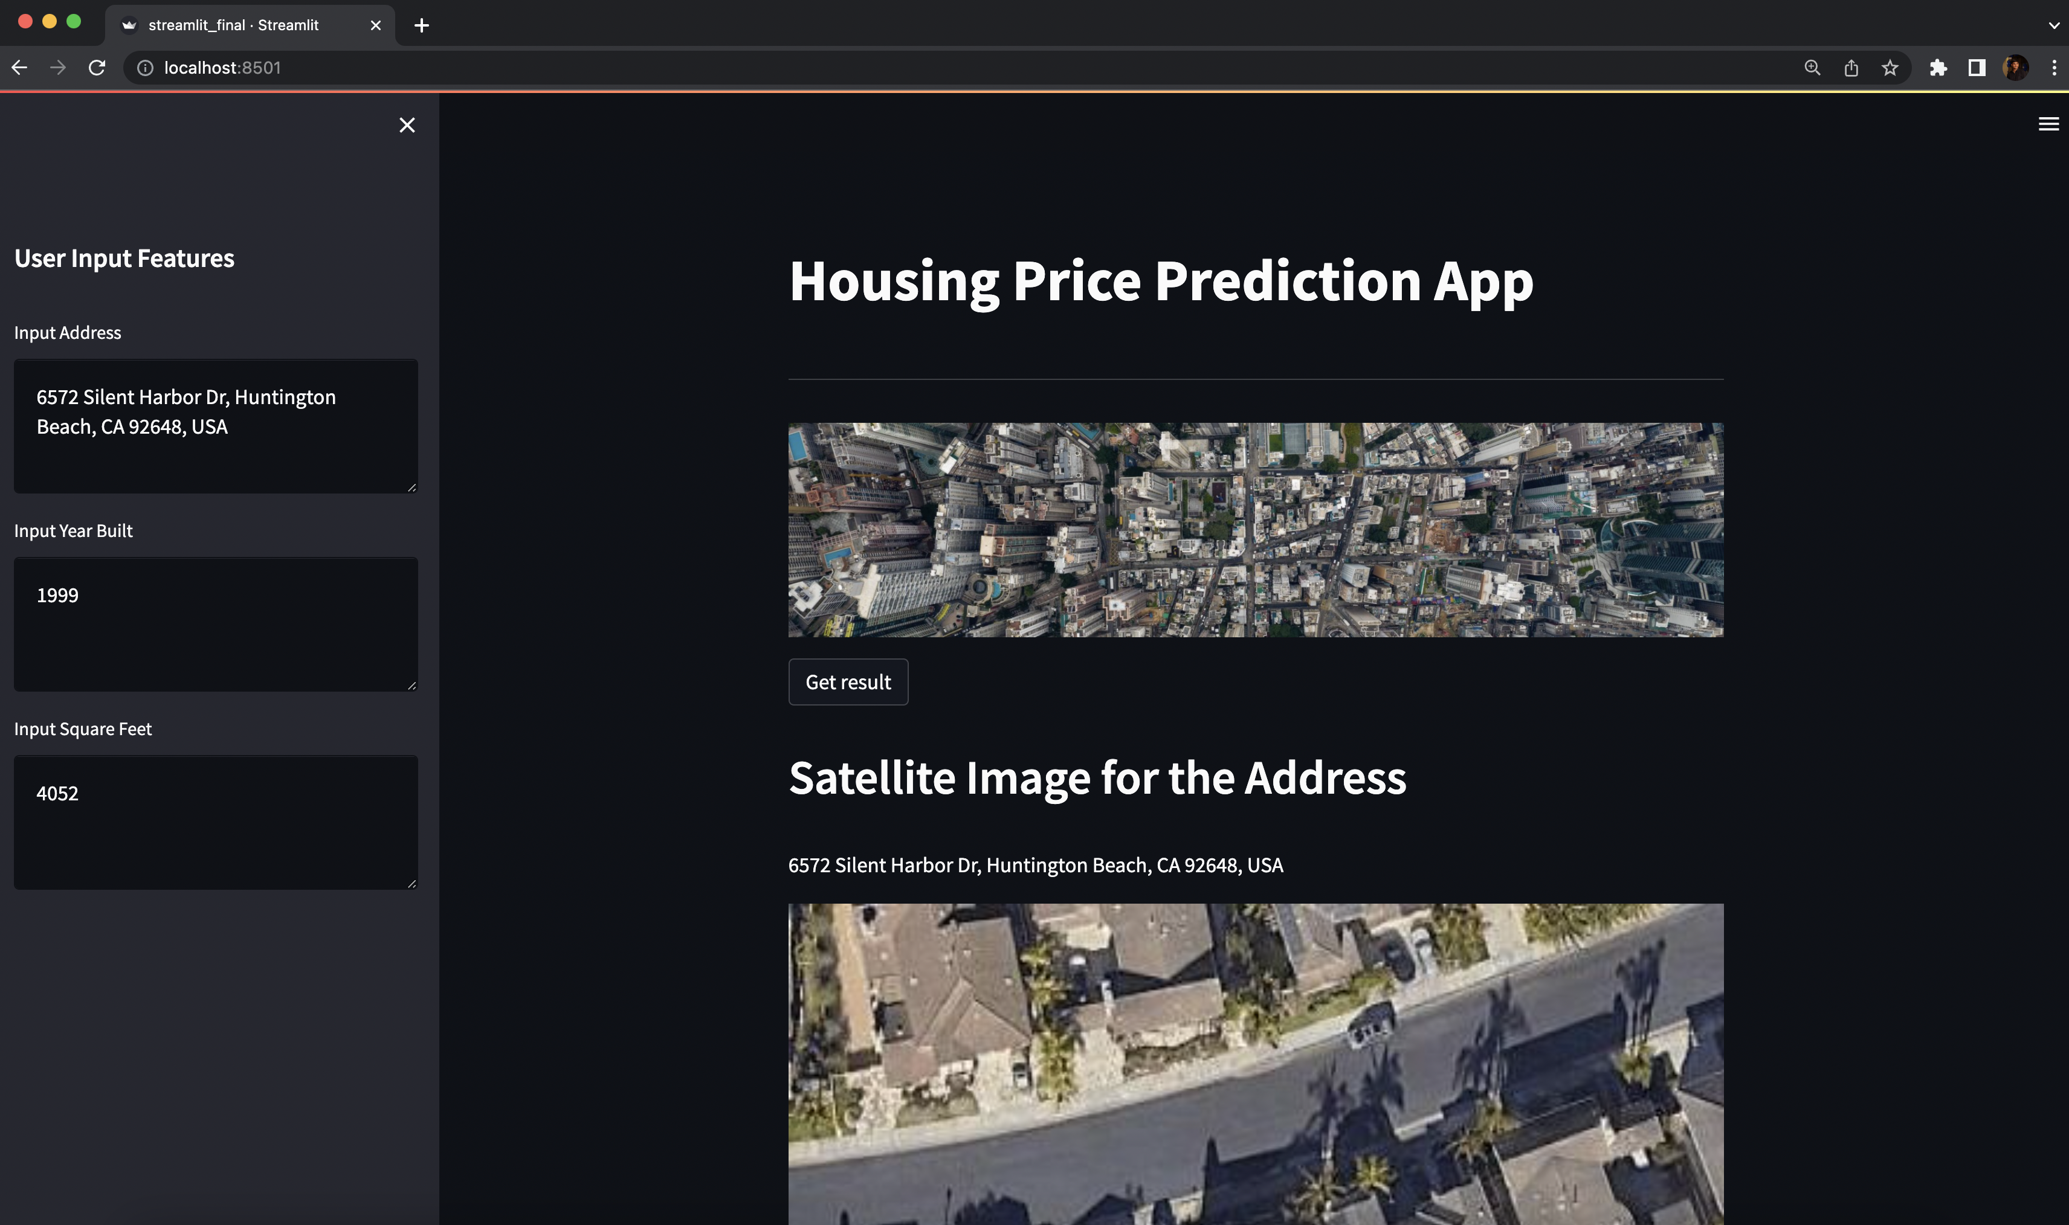
Demo

Slide 7
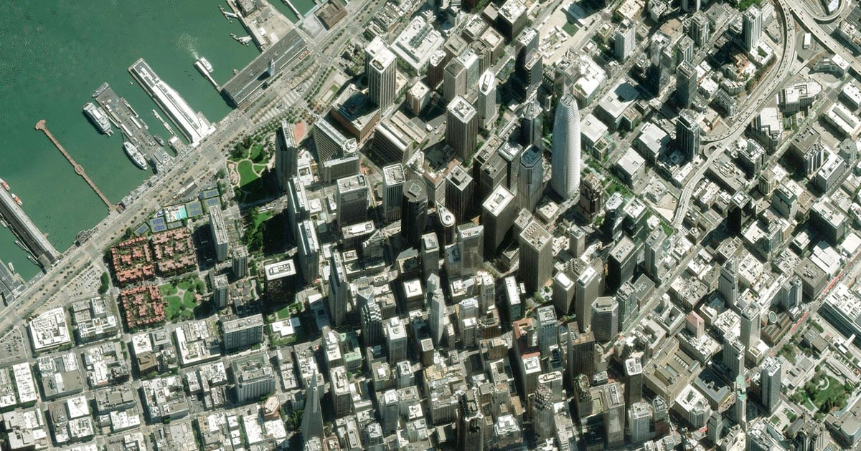
Challenges
Reliable and up-to-date property Data is still hard and costly to acquire – Kaggle dataset used was from 2017
Satellite Images may not always have all the features required – number of floors, garage spaces, basement sq. footage etc.
Real estate prices may be highly variable and depend on many volatile factors – recessions, time of year, govt. decisions etc.

Slide 8

Things to do next
Add more varied data sources – Project sunroof, Street View, Places API
Explore unsupervised learning
Expand to commercial properties
Predicting other useful parameters -
Property condition/maintenance and repair
Solar potential – Sustainability
Over/under valued neighborhoods/properties
Development potential for neighborhoods
Walkability – Distance to key places
Safety scoring of neighborhoods

Slide 9
Thank you

